Slide 1

Introductory Statistics
Introductory Statistics

Slide 2
Describing Categorical Data: Proportions; Sampling Distribution of a Sample Proportion
Categorical vs. Quantitative - Graphs
Distribution of Sample Proportion
Finding probability for distribution of Sample Proportions

Slide 3
Quantitative vs Categorical
Quantitative (Usually Numerical)
Ex. Height, Body Temperature, Cost of new medical equipment Number of Siblings, Typical Questionnaire ratings,
Categorical (Usually Non-numerical)
Ex. Gender, Class in College, Race, Phone Number

Slide 4
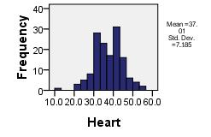
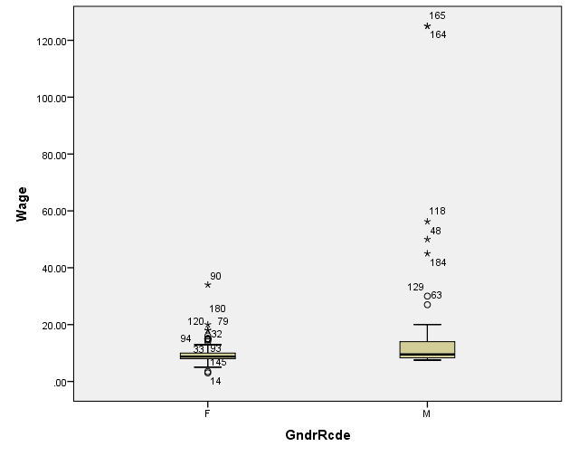
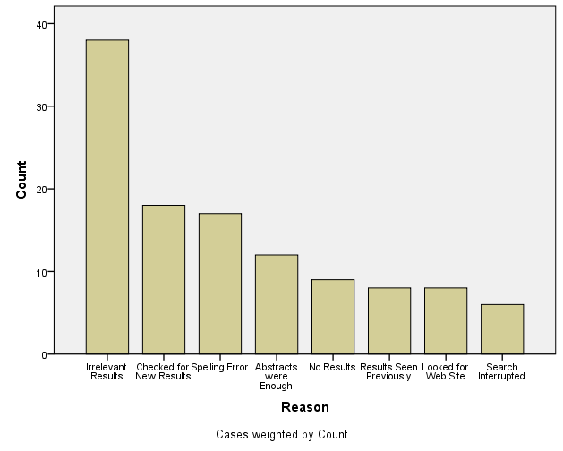
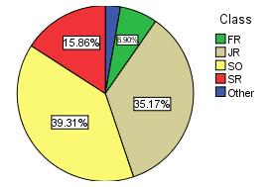
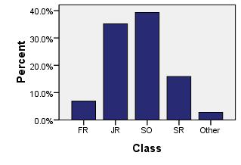
Graphing – Categorical vs. Quantitative
Quantitative
Categorical
Histogram
Boxplot
Pie Chart
Bar Graph
Pareto Chart

Slide 5
Categorical vs. Quantitative
Quantitative Data –Unit 2
Parameter of interest for the Population -> µ (population mean)
Categorical Data – Unit 3
Parameter of interest for the Population -> p (population Proportion)
The start of this unit we will look at data that has two categories – those observations that have a certain characteristic and those that do not.

Slide 6
Describing Categorical Data: Proportions; Sampling Distribution of a Sample Proportion
Categorical vs. Quantitative - Graphs
Distribution of Sample Proportion
Finding probability for distribution of Sample Proportions

Slide 7
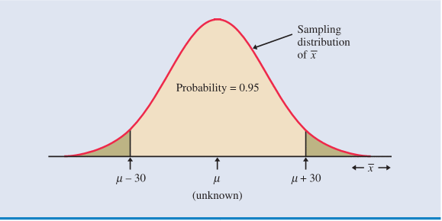
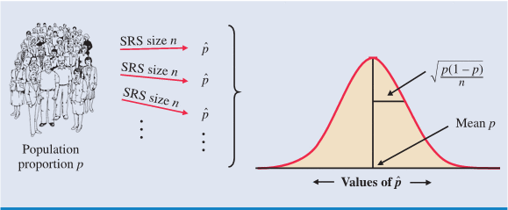
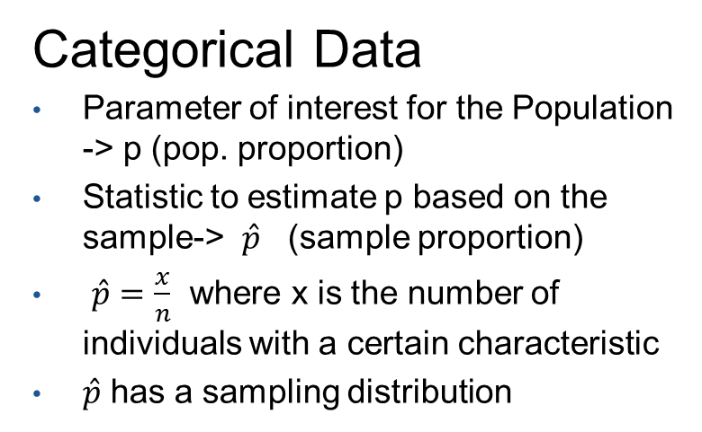
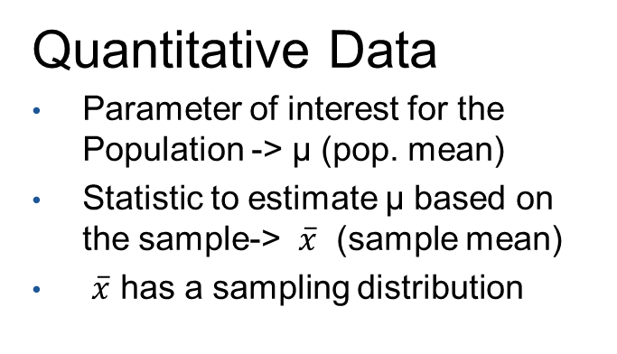
Estimation and Sampling Distribution
Quantitative Data
Parameter of interest for the Population -> µ (pop. mean)
Statistic to estimate µ based on the sample-> $\overline{x}$ (sample mean)
$\overline{x}$ has a sampling distribution
Categorical Data
Parameter of interest for the Population -> p (pop. proportion)
Statistic to estimate p based on the sample-> $\hat{p}$ (sample proportion)
$\hat{p}=\frac{x}{n}$ where x is the number of individuals with a certain characteristic
$\hat{p}$ has a sampling distribution
“The Distribution of Nickels”

Slide 8
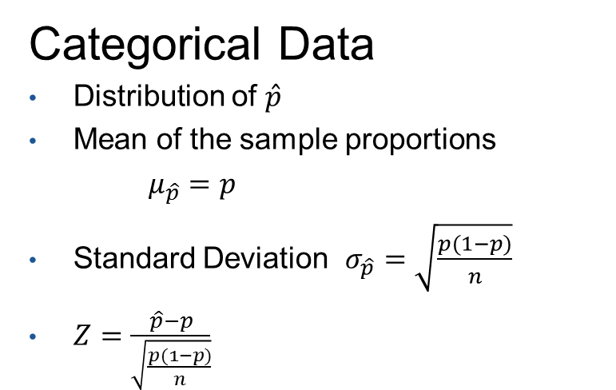
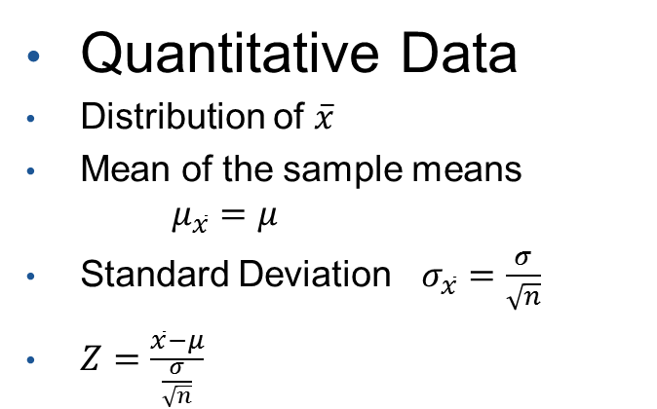
Estimation and Sampling Distribution
Quantitative Data
Distribution of $\overline{x}$
Mean of the sample means $μ_{\overline{x}}=μ$
Standard Deviation $σ_{\overline{x}}=\frac{σ}{\sqrt{n}}$
$Z=\frac{\overline{x}−μ}{\frac{σ}{\sqrt{n}}}$
Categorical Data
Distribution of $\hat{p}$
Mean of the sample proportions
$μ_{\hat{p}}=p$
Standard Deviation $σ_{\hat{p}}=\sqrt{\frac{p(1−p)}{n}}$
$Z=\frac{\hat{p}−p}{\sqrt{\frac{p(1−p)}{n}}}$
“The Distribution of Nickels”

Slide 9
Describing Categorical Data: Proportions; Sampling Distribution of a Sample Proportion
Categorical vs. Quantitative - Graphs
Distribution of Sample Proportion
Finding probability for distribution of Sample Proportions

Slide 10
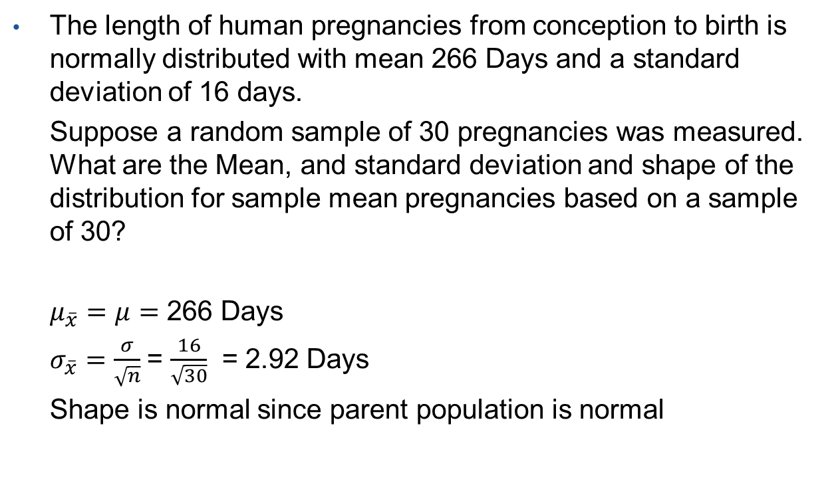
Sampling Distribution when Distribution of Population Data is Normally Distributed
The length of human pregnancies from conception to birth is normally distributed with mean 266 Days and a standard deviation of 16 days.
Suppose a random sample of 30 pregnancies was measured. What are the Mean, and standard deviation and shape of the distribution for sample mean pregnancies based on a sample of 30?
$μ_{\overline{x}}=μ=$ 266 Days
$σ_{\overline{x}}=\frac{σ}{\sqrt{n}}$= $\frac{16}{\sqrt{30}}$ = 2.92 Days
Shape is normal since parent population is normal

Slide 11
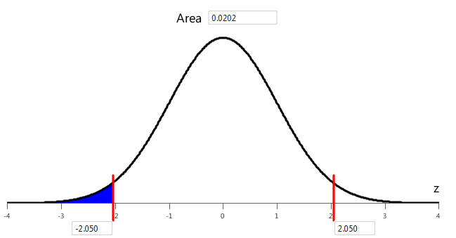
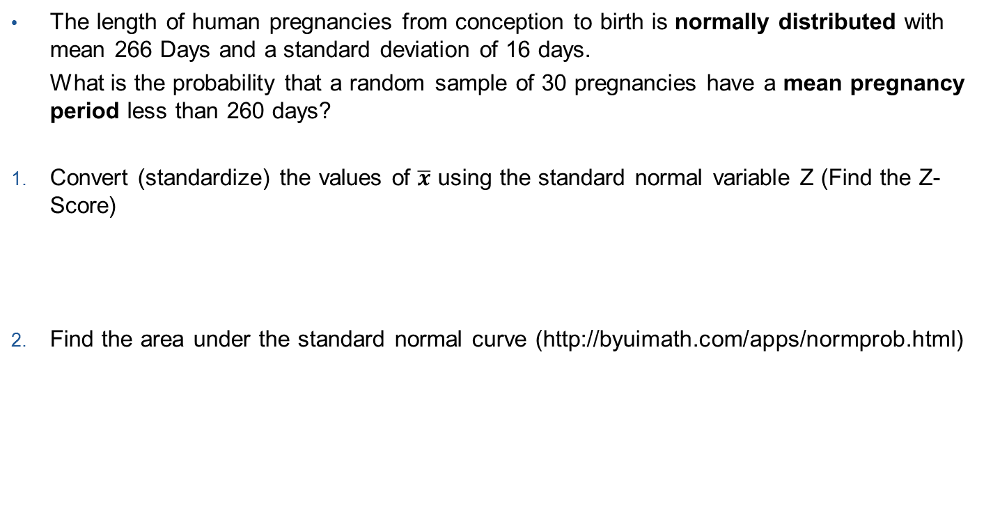
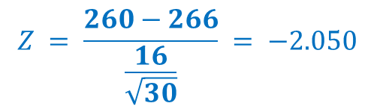
Steps to Finding Area or Probability Under a Sampling Distribution
The length of human pregnancies from conception to birth is normally distributed with mean 266 Days and a standard deviation of 16 days.
What is the probability that a random sample of 30 pregnancies have a mean pregnancy period less than 260 days?
Convert (standardize) the values of $\overline{x}$ using the standard normal variable Z (Find the Z-Score)
Find the area under the standard normal curve (http://byuimath.com/apps/normprob.html)
$$Z = \frac{260−266}{\frac{16}{\sqrt{30}}} = −2.050$$
0.0202

Slide 12

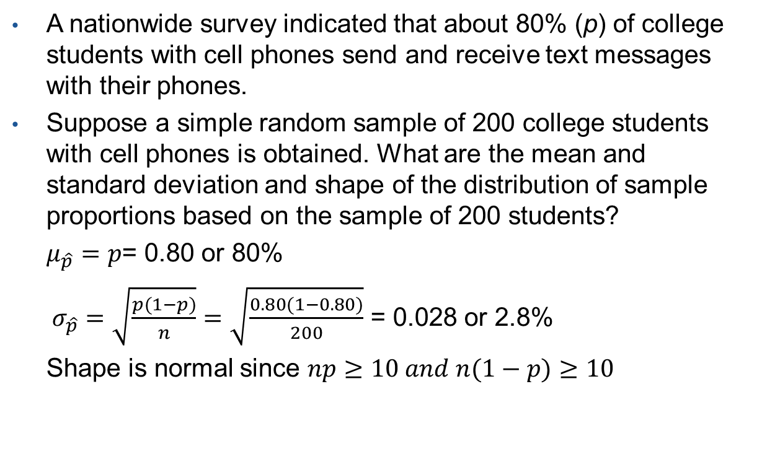
Sampling Distribution of Proportions ($\hat{p}$ )
A nationwide survey indicated that about 80% (p) of college students with cell phones send and receive text messages with their phones.
Suppose a simple random sample of 200 college students with cell phones is obtained. What are the mean and standard deviation and shape of the distribution of sample proportions based on the sample of 200 students?
$μ_{\hat{p}}=p$= 0.80 or 80%
$σ_{\hat{p}}=\sqrt{\frac{p(1−p)}{n}}=\sqrt{\frac{0.80(1−0.80)}{200}}$ = 0.028 or 2.8%
Shape is normal since $np≥10 and n(1−p)≥10$

Slide 13
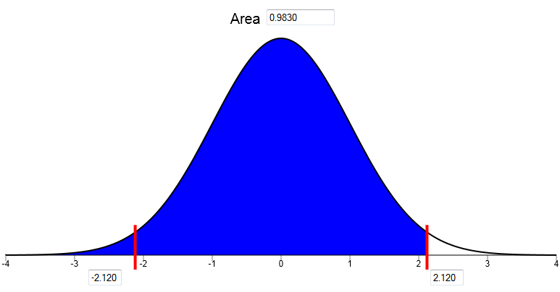
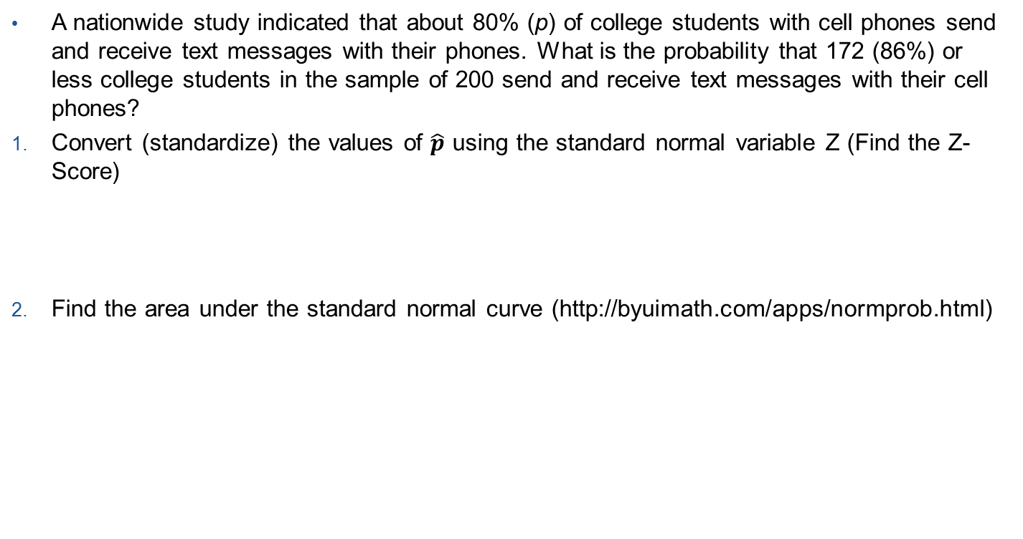

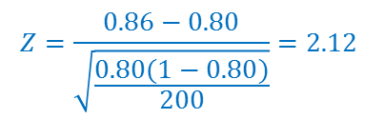
Steps to Finding Area or Probability Under Normal Curve for Sample Proportions
A nationwide study indicated that about 80% (p) of college students with cell phones send and receive text messages with their phones. What is the probability that 172 (86%) or less college students in the sample of 200 send and receive text messages with their cell phones?
Convert (standardize) the values of $\hat{p}$ using the standard normal variable Z (Find the Z-Score)
Find the area under the standard normal curve (http://byuimath.com/apps/normprob.html)
$$Z=\frac{0.86−0.80}{\sqrt{\frac{0.80(1−0.80)}{200}}}=2.12$$
$$Z=\frac{\hat{p}−p}{\sqrt{\frac{p(1−p)}{n}}}$$
0.9830

Slide 14
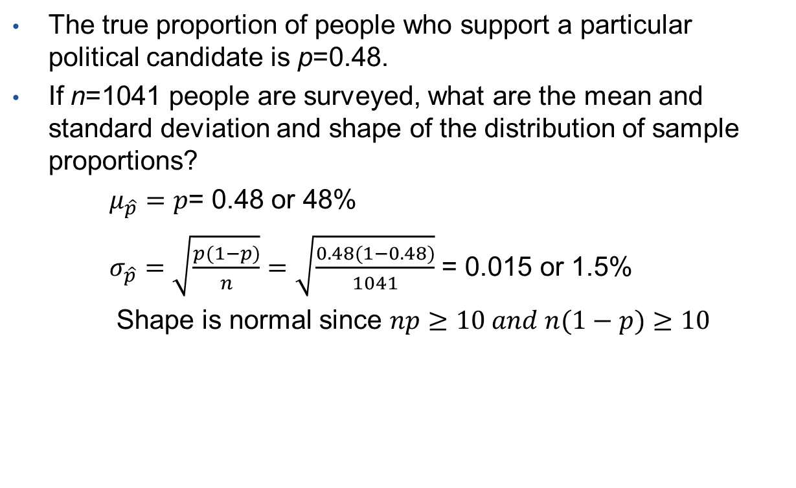
Sampling Distribution of Proportions ($\hat{p}$ )
The true proportion of people who support a particular political candidate is p=0.48.
If n=1041 people are surveyed, what are the mean and standard deviation and shape of the distribution of sample proportions?
$μ_{\hat{p}}=p$= 0.48 or 48%
$σ_{\hat{p}}=\sqrt{\frac{p(1−p)}{n}}=\sqrt{\frac{0.48(1−0.48)}{1041}}$ = 0.015 or 1.5%
Shape is normal since $np≥10 and n(1−p)≥10$

Slide 15
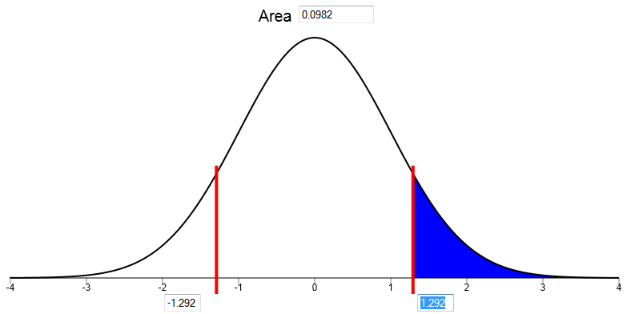
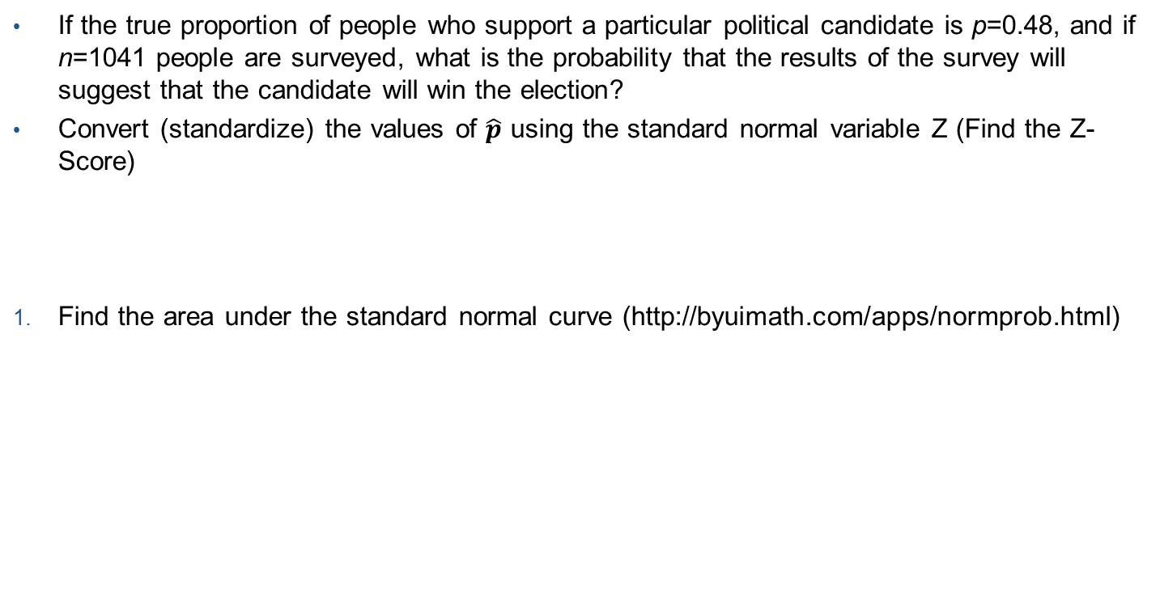
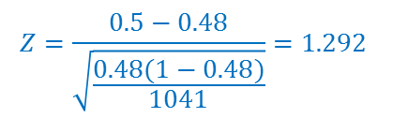
Steps to Finding Area or Probability Under Normal Curve for Sample Proportions
If the true proportion of people who support a particular political candidate is p=0.48, and if n=1041 people are surveyed, what is the probability that the results of the survey will suggest that the candidate will win the election?
Convert (standardize) the values of $\hat{p}$ using the standard normal variable Z (Find the Z-Score)
Find the area under the standard normal curve (http://byuimath.com/apps/normprob.html)
$$Z=\frac{0.5−0.48}{\sqrt{\frac{0.48(1−0.48)}{1041}}}=1.292$$
$$Z=\frac{\hat{p}−p}{\sqrt{\frac{p(1−p)}{n}}}$$
0.0982

